Slide 1
Student Mental Health
Developing a strategy

Slide 2

Student wellbeing and mental health
Trends
General wellbeing
Social isolation
Anxiety, depression
Perfectionism
Substance use
Suicidal ideation

Slide 3

Institutional context
University Strategy 2016
Student wellbeing priority
£1M investment
Student Wellbeing Service
Residential Life Service
Student deaths by suicide
Media coverage

Slide 4

Support for student wellbeing
Whole institution approach
New services
Proactive support
Community building
Skills development
Additional support

Slide 5









bristol.ac.uk
Bristol’s whole-institution model for pastoral care

Slide 6

University-wide
Student Counselling
Students’ Health
Disability Services
Sport Exercise and Health
Bristol SU
Report and Support
Suicide Prevention and Response

Slide 7

Residences
Residential Life Service
Transition to independent living
Inclusive community building
Residential life programme (SEH/Bristol SU)
Life skills development
Additional support needs

Slide 8

Faculties and Schools
Student Wellbeing Service
Transition to study in HE
Inclusive community building
Wellbeing self-management
Personal Tutoring / PDP
Peer led support
Additional support needs

Slide 9
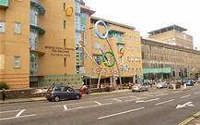
External Partnerships
Public Health
Bristol Thrive
Substance misuse
Suicide Prevention and Response
NHS
Strategic and operational
Access to Primary and Secondary Care
Service design

Slide 10
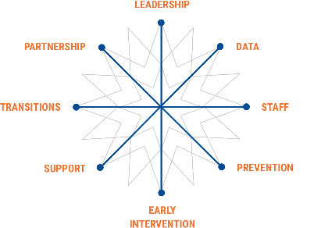
UUK Strategy Framework

Slide 11

Mental Health and Wellbeing Strategy
VC’s Taskforce
UUK Framework Review
Staff and student strategy development
Strategy Action Plans
Annual Report to Board
Transition to business as usual

